Slide 1

Umamaheswaran Manivannan
Senior Software Engineer – BizTalk360
Analytics using Application Insights

Slide 2
The goal is to turn data into information, and information into insight.

Slide 3
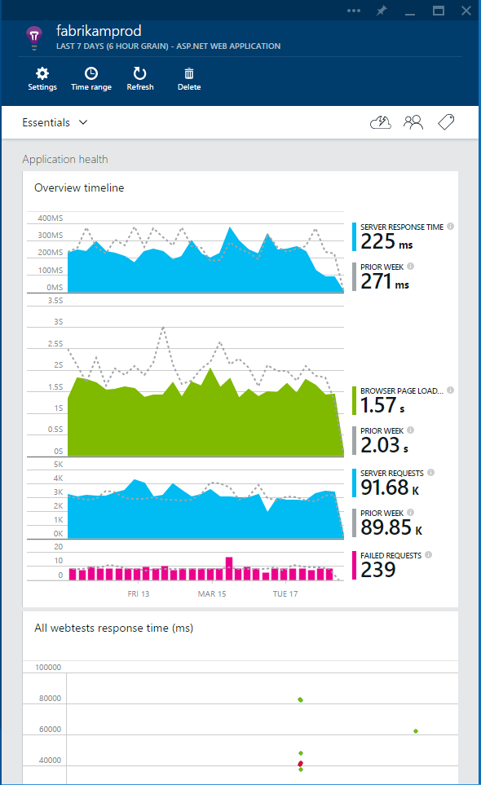
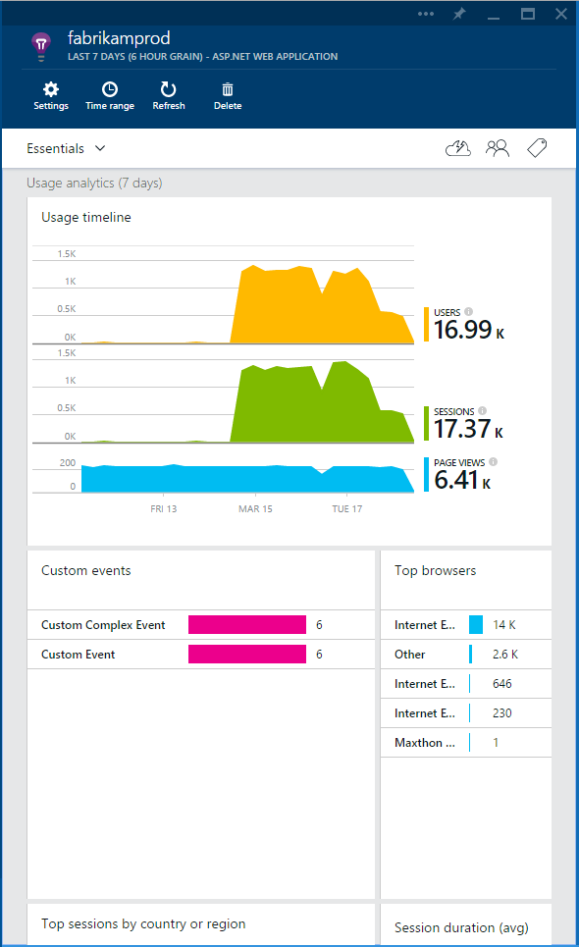
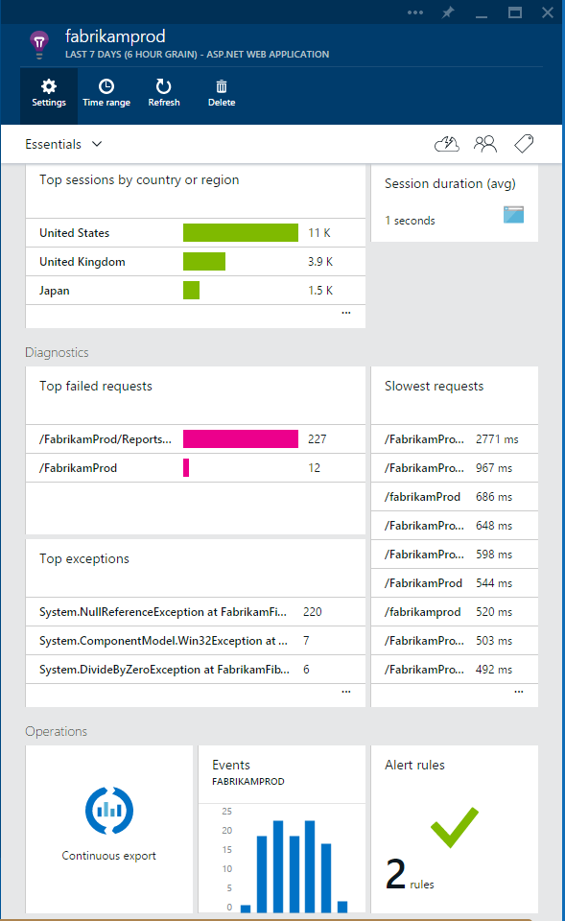


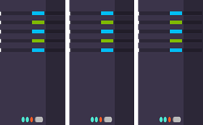
What is Application Insights?
3
Get a 360° view of the application including availability, performance and usage patterns
1
Telemetry is collected at each tier: mobile applications, server applications and browser
2
Telemetry arrives in the Application Insights service in the cloud where it is processed & stored

Slide 4




Sources of Telemetry
1
Outside-in monitoring
URL pings and web tests from 16 global points of presence
2
Observed user behavior
How is the application being used?
3
Developer traces and events
app
Whatever the developer would like to send to Application Insights
4
Observed application behavior
platform
No coding required – service dependencies, queries, response time, exceptions, logs, etc.
infrastructure
Infrastructure performance
5
System performance counters

Slide 5









Key capabilities
Any app support
Easily add analytics across multiple platforms including: ASP.NET, Java/J2EE, iOS, Android, Windows, as well as OSS technologies such as Node.JS, PHP, Ruby, Python, etc.
Open source SDK: https://github.com/Microsoft/ApplicationInsights-Home
Logging framework: Log4Net, nLog, System.Diagnostics Log4J, Logback

Slide 6
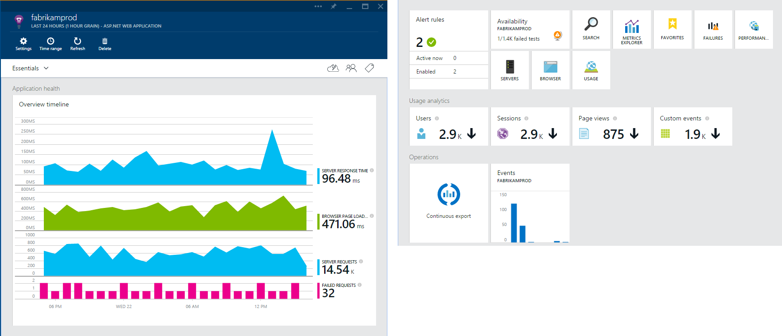
Overview Blade
Out of the box experience
Provides a summary of the application’s health - availability, performance and usage
Paired timeline allows users to quickly correlate metrics and identify trends

Slide 7
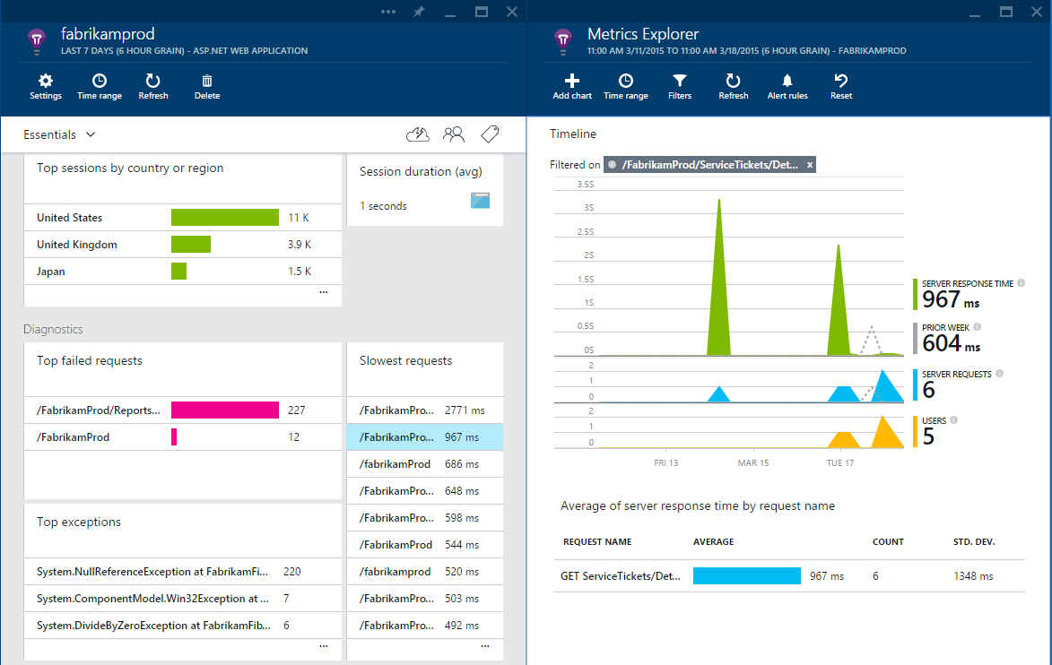
Drill down
Detailed insights with the click of a button
Correlate performance and usage in a single view
Pinpoint problems and investigate questions like “Do I have network performance issues that hurt user adoption?”
Click on specific metric and drill into detailed information and answer questions such as “what request is failing the most?”

Slide 8
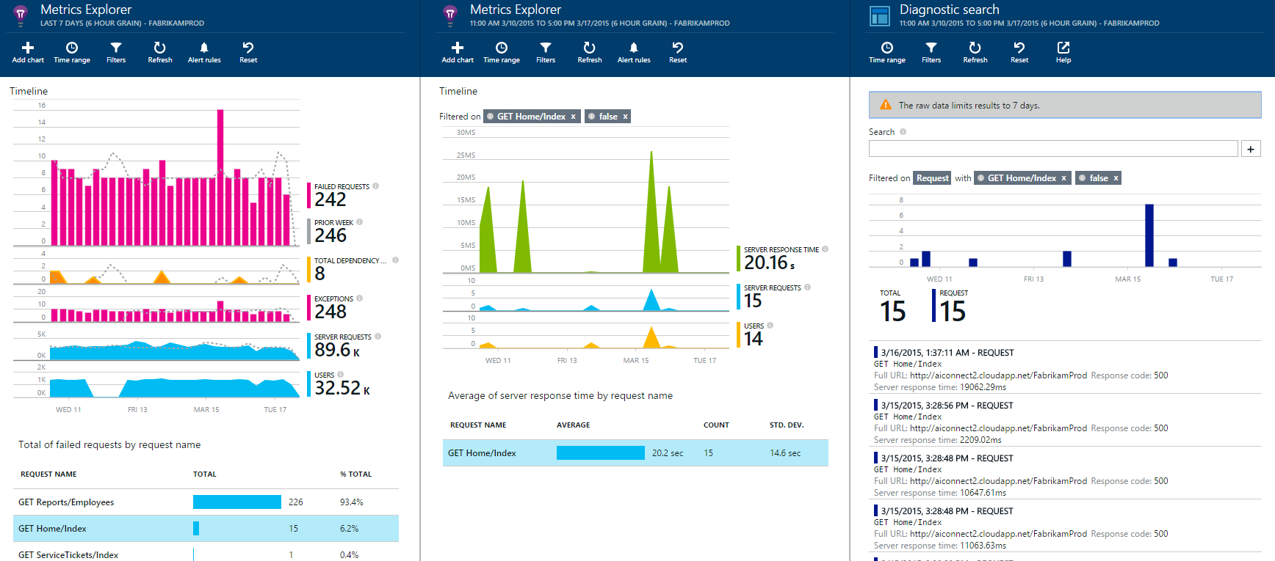
Drill down tools
Powerful insights with Metrics Explorer and Diagnostic Search
Metrics Explorer provides a flexible multi-dimensional UI over custom and out-of-the-box telemetry collected
Diagnostic Search enables efficient search over large sets of data using the query experience

Slide 9
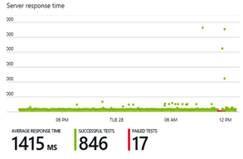
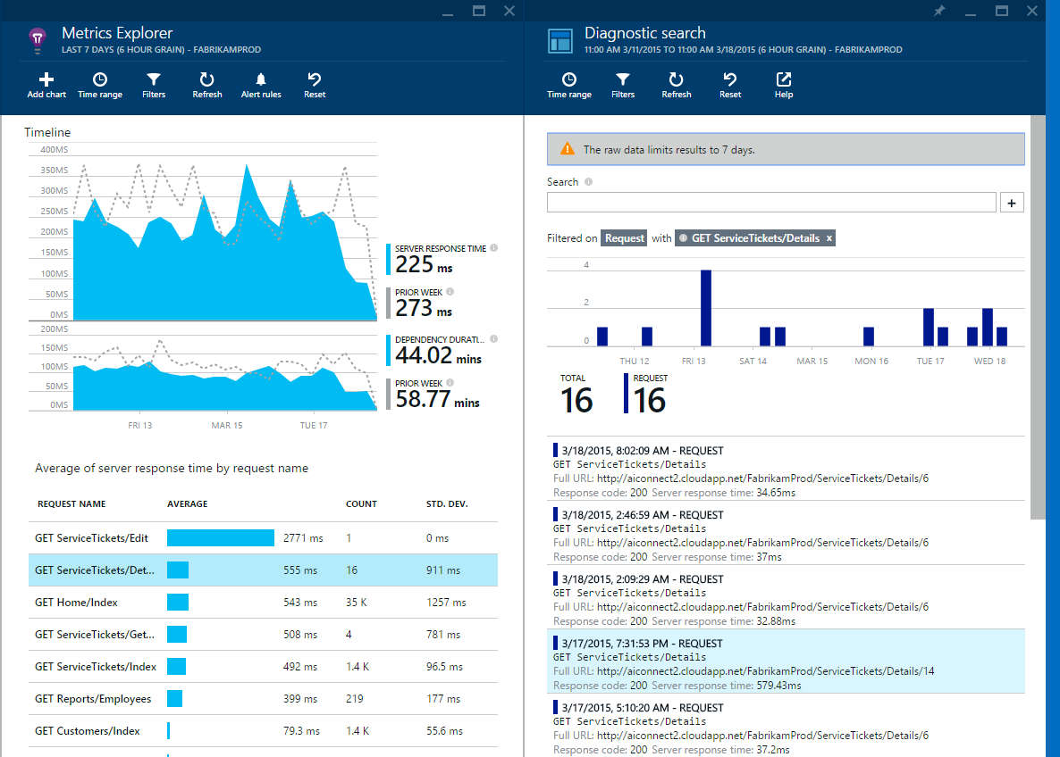
Fast and powerful insights
Identify & triage availability issues
Monitor your web sites with simple pings to complex web tests from points around the world
Diagnose & solve performance problems
Quickly diagnose issues by accessing rich application performance data from the client view to dependencies
Mobile crash/sever exception analytics
Real time view of crashes happening on devices, allowing you to focus on fixing key issues with the biggest impact first

Slide 10
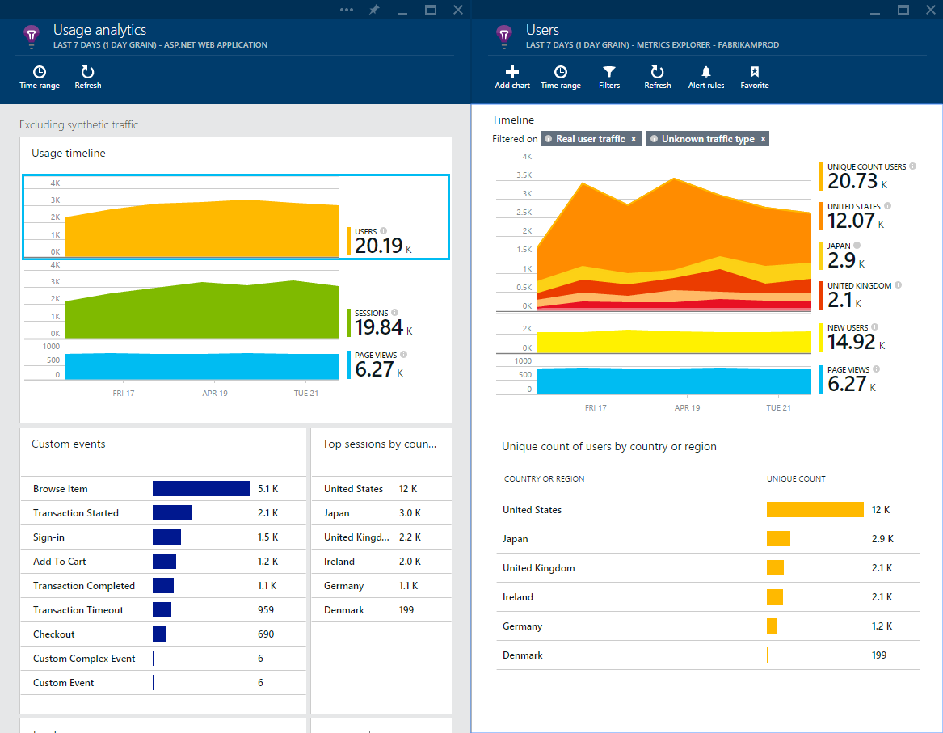
Fast and powerful insights
Learn & improve with usage insights
Understand where your users are coming from and where they spend most of their time
Prioritize future investments and continuously improve your app based on user activity and usage patterns and trends

Slide 11
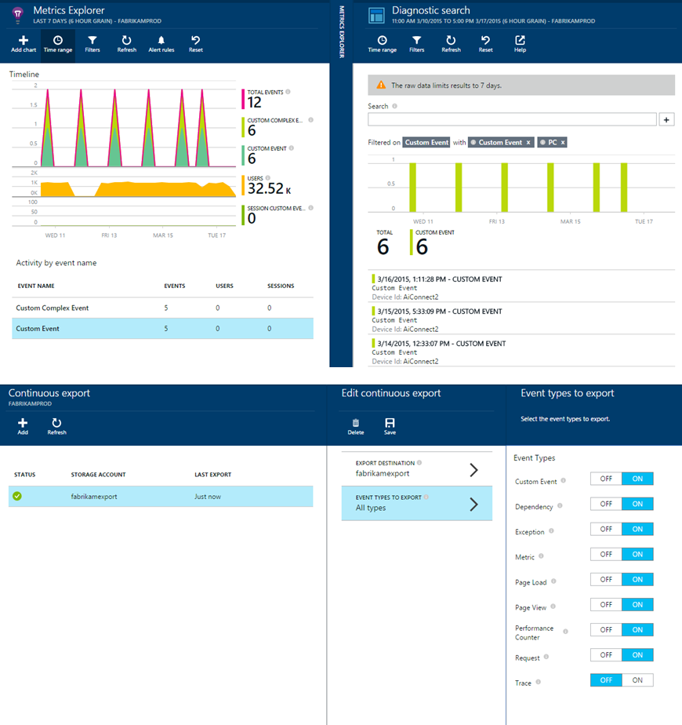
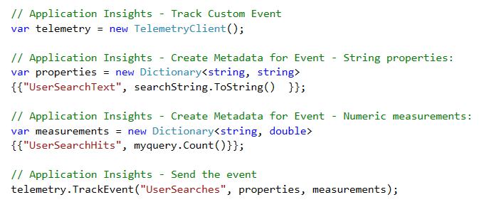
Fast and powerful insights
Extend telemetry data
Add custom metrics and events to better track and analyze user activity
Continuously Export data to Azure Blob Storage for custom integration with other data sources and further analysis

Slide 12
DEMO

